Slide 1
Expressing an arithmetic sequence
Sequences

Slide 2
how to use Oak lessons

Slide 3
I can appreciate that any term in an arithmetic sequence can be expressed in terms of it’s position in the sequence.

Slide 4
The n^{th} term of a sequence is the position of a term in a sequence where n stands for the term number.
For example, if n = 10 this means the 10th term in the sequence.

Slide 5

Expressing an arithmetic sequence
The position of a term in a sequence
The general term of a sequence

Slide 6
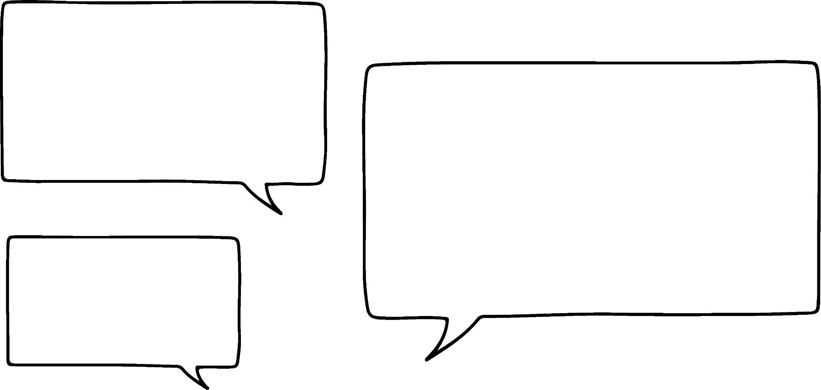



The position of a term in a sequence
Our Oak students are discussing expressions.
How do you express the perimeter of any rectangle?
h
b
b + b + h + h
2b + 2h
2(b + h)
Sam
Jacob
Andeep
Who is right?

Slide 7
The position of a term in a sequence
Our Oak students are discussing expressions.
b
How do you express the perimeter of any rectangle?
h
h
b
b + b + h + h
2b + 2h
2(b + h)
Sam
Jacob
Andeep
All their expressions are correct however, Jacob and Andeep’s are simplified.
Sequences are no different. We want to express them as simply as possible too.

Slide 8
The position of a term in a sequence
Can you see a pattern in this sequence?
2, 4, 6, 8, 10, …
The term-to-term rule is +2
It’s our 2 times table.
Andeep says:
The 100th term in this sequence is 200.
Is he right?
Is so, why?

Slide 9

The position of a term in a sequence
Can you see a pattern in this sequence?
2, 4, 6, 8, 10, …
Term number | 1 | 2 | 3 | 4 | 5
Term value | 2 | 4 | 6 | 8 | 10
×2
The term-to-term rule is +2
It’s our 2 times table.
Andeep says:
The 100th term in this sequence is 200.
Is he right?
Is so, why?
He is right because the term value is always twice the term number in the 2 times table.

Slide 10

The position of a term in a sequence
5, 10, 15, 20, 25, …
Term number | 1 | 2 | 3 | 4 | 5
Term value | 5 | 10 | 15 | 20 | 25
×5
What relationship helps us find any term number in this sequence?
Multiply the term number by 5
Alex is right. This works for all terms in the sequence. Example, the 10th term is 10 × 5 = 50
Alex
Whilst the language is precise, it is not very efficient. To improve efficiency we say n to mean any term number.

Slide 11
The position of a term in a sequence
5, 10, 15, 20, 25, …
 | 1 | 2 | 3 | 4 | 5
Term value | 5 | 10 | 15 | 20 | 25
Term number (n)
×5
The n^{th} term of a sequence is the position of a term in a sequence where n stands for the term number.
n = 10 means the 10th number in the sequence.
Alex can now say:
Multiply n by 5
Using n the language has become more concise.

Slide 12

The position of a term in a sequence
In sequences we use the letter n to represent what?
In sequences n represents our term number.
The term number.
The term value.
The relationship between term number and term value.

Slide 13
The position of a term in a sequence
In sequences, n = 5 means what?
The term value will be determined by the relationship between n and the term value.
n = 5 means the 5th term number.
The solution to the equation is 5.
The value of the term is 5.
The 5th term number.

Slide 14
The position of a term in a sequence
When discussing the 100th term number which would we use?
100 is just a number.
n + 100 is an expression.
n = 100 means the 100th number in a sequence.
100
n + 100
n = 100

Slide 15

The position of a term in a sequence
Aisha and Jun are laying out tables in the dining room and they notice a pattern.
8, 10, 12, 14, … The number of people makes an arithmetic sequence.
Is Jun correct?
Yes. A common difference of +2 makes it arithmetic.

Slide 16

The position of a term in a sequence
Aisha and Jun are laying out tables in the dining room and they notice a pattern.
I have a rule! The number of tables ×2 add the 6 on the sides = number of people
Does her rule work?
Yes. (1) × 2 + 6 = 8
(2) × 2 + 6 = 10
(3) × 2 + 6 = 12
(4) × 2 + 6 = 14

Slide 17
The position of a term in a sequence
Aisha and Jun put their results in a table.
Table number (n) | 1 | 2 | 3 | 4
People | 8 | 10 | 12 | 14
If n represents the number of tables my rule is easier to say. n × 2 + 6 = number of people
Your rule works Aisha!
When n = 4 we have
(4) × 2 + 6 = 14 people.

Slide 18
The position of a term in a sequence
Aisha and Jun put their results in a table.
Table number (n) | 1 | 2 | 3 | 4
People | 8 | 10 | 12 | 14
If n represents the number of tables my rule is easier to say. n × 2 + 6 = number of people
What if…
I use n = −2 we’ll have
(−2) × 2 + 6 = 2 people.
What is wrong with Jun’s idea?

Slide 19
The position of a term in a sequence
Aisha and Jun put their results in a table.
Table number (n) | 1 | 2 | 3 | 4
People | 8 | 10 | 12 | 14
If n represents the number of tables my rule is easier to say. n × 2 + 6 = number of people
What if…
I use n = −2 we’ll have
(−2) × 2 + 6 = 2 people
This would mean −2 tables. −2, −1, or zero tables won’t exist. n has to be a positive integer in this case.

Slide 20
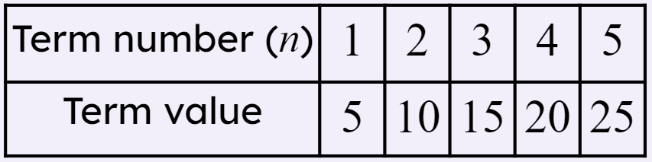
The position of a term in a sequence
n, the term number, can be zero.
Because any number multiplied by zero is zero.
5 is the first number in this sequence, there is nothing before it.
Because the first term in a sequence is the first term. There is nothing before it.

Slide 21
The position of a term in a sequence
1) Match the term number (n) to the term values (T). One has been done for you.
a)
b)
Term number (n) | 1 | 2 | 3 | 4 | 5
Term value (T) | 2 | 5 | 8 | 11 | 14
Term number (n) | 1 | 2 | 3 | 4 | 5
Term value (T) | 5 | 4 | 3 | 2 | 1
n = 1
T = 14
n = 1
T = 1
n = 2
T = 4
n = 2
T = 2
n = 3
T = 2
n = 3
T = 8
n = 4
T = 3
n = 5
T = 5
n = 5
T = 5

Slide 22


The position of a term in a sequence
2) Andeep and Jacob are looking at an arithmetic sequence.
Term number (n) | 1 | 2 | 3 | 4 | 5
Term value (T) | 45 | 40 | 35 | 30 | 25
I see the pattern!
When n = 0 the term is 50
I agree! Next would be
when n = −1
The term will be 55
Write a sentence explaining why Andeep and Jacob are wrong.

Slide 23
The position of a term in a sequence
1) Match the term number (n) to the term values (T). One has been done for you.
a)
b)
Term number (n) | 1 | 2 | 3 | 4 | 5
Term value (T) | 2 | 5 | 8 | 11 | 14
Term number (n) | 1 | 2 | 3 | 4 | 5
Term value (T) | 5 | 4 | 3 | 2 | 1
n = 1
T = 14
n = 1
T = 1
n = 2
T = 4
n = 2
T = 2
n = 3
T = 2
n = 3
T = 8
n = 4
T = 3
n = 5
T = 5
n = 5
T = 5

Slide 24
The position of a term in a sequence
2) Andeep and Jacob are looking at an arithmetic sequence.
Term number (n) | 1 | 2 | 3 | 4 | 5
Term value (T) | 45 | 40 | 35 | 30 | 25
I see the pattern!
When n = 0 the term is 50
I agree! Next would be
when n = −1
The term will be 55
You might have written:
There is no zero term, or −1 term in this sequence.
The first term 45, where n = 1, is the first number in this sequence. There is nothing before it.

Slide 25
Expressing an arithmetic sequence
The position of a term in a sequence
The general term of a sequence

Slide 26
The general term of a sequence
5, 10, 15, 20, 25, …
Term number (n) | 1 | 2 | 3 | 4 | 5 | 10 | 25 | 100 | n
Term value (T) | 5 | 10 | 15 | 20 | 25 | 50 | 125 | 500 | n × 5
×5
What is the 10th number in the sequence?
What is the 25th number in the sequence?
What is the 100th number in the sequence?
What is the n^{th} number in the sequence?
n × 5
Using n we can write a general rule for our sequence.

Slide 27
The general term of a sequence
What would a general rule for this sequence be?
Term number (n) | 1 | 2 | 3 | 4 | 5 | n
Term value (T) | 7 | 14 | 21 | 28 | 35 | n × 7
×7
n = 7
n + 7
n × 7
The general term for this sequence is n × 7

Slide 28
The general term of a sequence
Using n we can write a general rule for any arithmetic sequence.
,
,
, …
Pattern number (n) | 1 | 2 | 3 | 4 | 5 | 10 | 25 | 100 | n
Number of green squares (T) | 4 | 8 | 12 | 16 | 20 | 40 | 100 | 400 | n × 4
Can you fill in this table and write a general rule?
n × 4 is a general rule for this sequence.

Slide 29
The general term of a sequence
Same pattern, but what if we now say, “All squares”?
Pattern number (n) | 1 | 2 | 3
Number of squares (T) | 5 | 9 | 13
,
,
, …
What is the general rule for this sequence?
All of our students’ rules work, but Aisha’s is the most concise.
4 times the pattern number, plus the middle 1
Pattern number ×4, plus 1
n × 4 + 1
Jun
Jacob
Aisha

Slide 30
The general term of a sequence
Match each pattern to it’s verbal rule and n^{th} term rule.
Pattern number times 2 plus 3
n × 3 + 1
,
,
, …
Pattern number times 2 plus 1
n × 2 + 3
,
,
, …
Pattern number times 3 plus 1
n × 2 + 1
,
,
, …

Slide 31
The general term of a sequence
1) Sam spots a general rule for this sequence.
,
,
, …
Pattern number | 1 | 2 | 3
Squares | 4 | 7 | 10
Pattern number | 1 | 2 | 3 | Pattern number
Squares | 4 | 7 | 10 | Pattern number × 3 + 1
Whilst their general rule works, how would you improve upon it?

Slide 32
The general term of a sequence
2) Fill in the table for this sequence and write a general rule each row.
,
,
,
, …
Pattern number (n) | 1 | 2 | 3 | 4 | 5 |  |  |  | n
Shaded squares | 2 |  |  |  |  | 50
Total squares |  | 8 |  |  |  |  | 200
Perimeter | 10 |  |  |  |  |  |  | 208

Slide 33
The general term of a sequence
1) Sam spots a general rule for this sequence.
,
,
, …
Pattern number | 1 | 2 | 3 | Pattern number
Squares | 4 | 7 | 10 | Pattern number × 3 + 1
Whilst their general rule works, how would you improve upon it?
You might have said, use n to represent the n^{th} term thus writing the rule more concisely.

Slide 34
The general term of a sequence
1) Sam spots a general rule for this sequence.
,
,
, …
Pattern number (n) | 1 | 2 | 3 | n
Squares | 4 | 7 | 10 | n × 3 + 1
Whilst their general rule works, how would you improve upon it?
You might have said, use n to represent the n^{th} term thus writing the rule more concisely.

Slide 35
The general term of a sequence
2) Fill in the table for this sequence and write a general rule each row.
,
,
,
, …
Pattern number (n) | 1 | 2 | 3 | 4 | 5 | 25 | 50 | 100 | n
Shaded squares | 2 | 4 | 6 | 8 | 10 | 50 | 100 | 200 | n × 2
Total squares | 4 | 8 | 12 | 16 | 20 | 100 | 200 | 400 | n × 4
Perimeter | 10 | 12 | 14 | 16 | 18 | 58 | 108 | 208 | n × 2 + 8

Slide 36
Expressing an arithmetic sequence
I can appreciate that any term in an arithmetic sequence can be expressed in terms of its position in the sequence.
n represents the term number.
n = 10 means the 10th number in the sequence.

Slide 37

© Oak National Academy 2023.
Produced in partnership with Mathematics in Education and Industry.
Licensed on the Open Government Licence v3.0, except where otherwise stated. See Oak terms and conditions.

